Slide 1
Team PRINT
Tyler Han, Nathan Spicer-Davis, Eric Oh, Rohith Chintala, Aidan Sandman-Long, Brendan Cutick, Elizabeth Myers, Cynthia Sheng

Slide 2
Introduction
In Situ Conformal 3d Printing For Targeted Repairs

Slide 3
Introduction

Slide 4
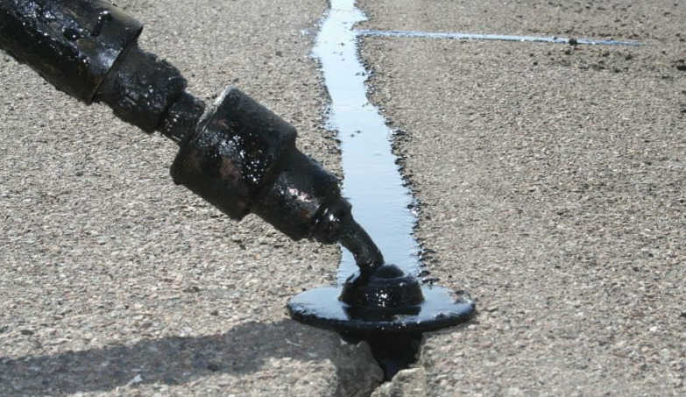
3D Printed Repairs
Advantages of Additive Manufacturing (AM) and 3D Printing
Precise material deposition
Create complex geometric shapes
Quick prototyping
Applications to medical implants
Sealant being used to repair pavement cracks
[1]
Notes:
One of the reasons why 3D printing has been so successful is the technology’s ability to place material precisely into the desired locations to create more complex geometries. There are also direct applications for AM in medical implantations where subtractive procedures clearly would not be permitted. Naturally, the question of whether or not you can use this ability to repair objects in general arises. In the same way roads are repaired by adding sealant, more complex geometric shapes can be repaired by building or reinforcing 3D prints.

Slide 5
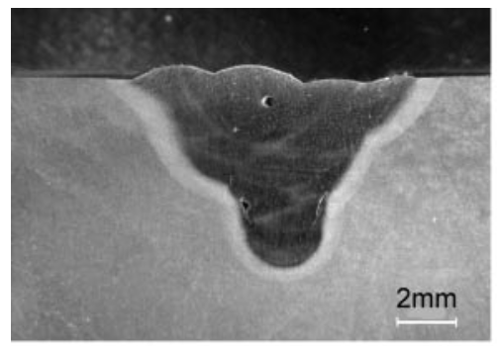
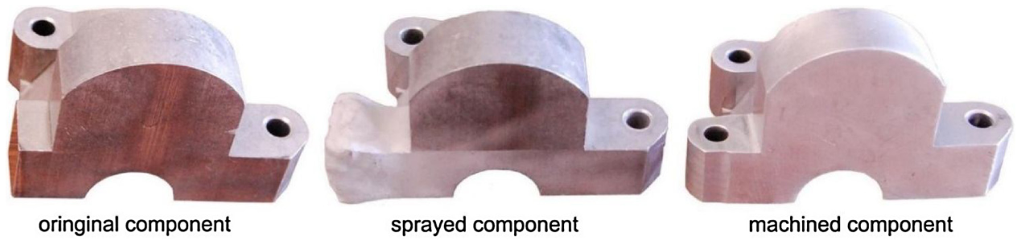
Existing Methods of AM Repairs
Direct Energy Deposition (DED)
Cold Spray Additive Manufacturing
[1]
[2]
Notes:
Direct Energy Deposition (DED) or Laser Metal Deposition (LMD)
Metal powder is injected and fused onto damaged surface using a high power laser as a heat source
Cold Spray Additive Manufacturing (CSAM)
Metal powder is injected at high enough velocity to fuse together from impact
Both are promising methods for repairing damaged components, but both still have issues
Rapid heating and cooling in the DED process can cause small defects within the deposited material impacting mechanical properties
CSAM repairs require machining the surface prior to and after deposition to ensure a smooth surface

Slide 6
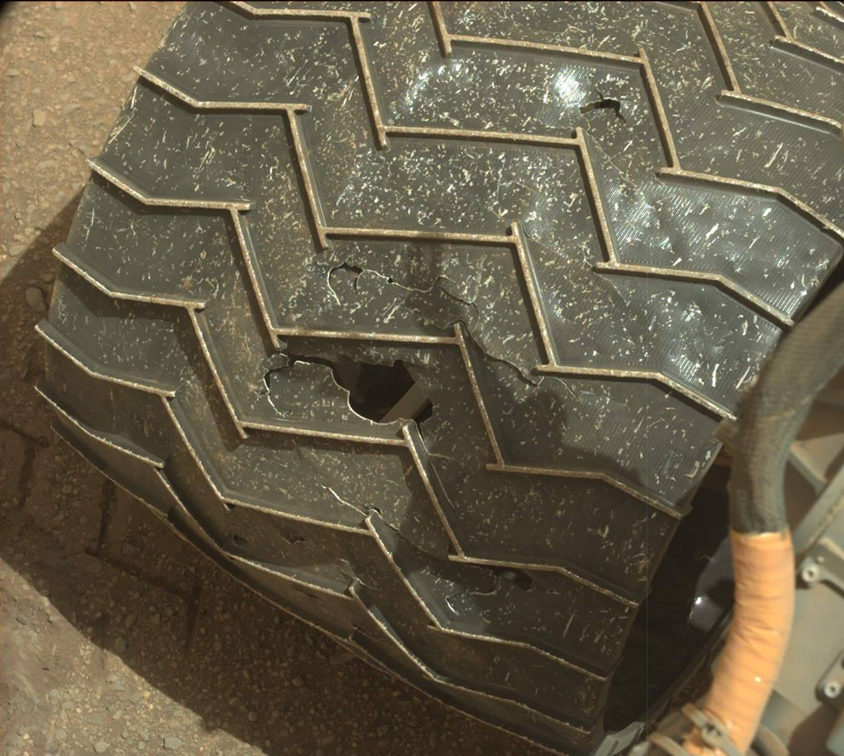
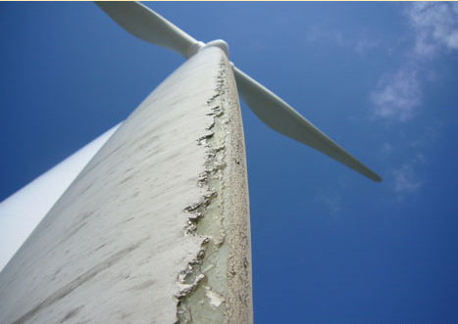
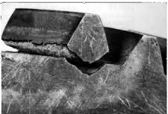
Potential Applications
Satellite servicing and extraterrestrial rover repair
NASA’s Curiosity Mars rover sustained tire damage (1-3 inch long tears)
3D-printed Rutherford rocket engine
Carbon fiber bike frames
Gears, brackets, hoses on the ISS
Windmill damage
[7]
Notes:
Why 3D print a repair in the first place? In some cases, it may not be possible to replace parts right away. For example, if parts are damaged in space, it would take months or even years to send a shipment of new parts.However, according to NASA’s database, approximately 28.6% of parts on the ISS that require replacement are plastics and composites, which can be repaired used FDM. Other potential cases for 3D printed repair include rover repair, bike frames, windmills, and the Rutherford rocket engine, which was also 3D printed.

Slide 7
Research Problem

Slide 8
How effective is repairing 3D printed structures with conformal 3D printing?

Slide 9
Our Research Focus
Conformal Printing literature dates back <10 years
Existing work lacks structural analysis
Provide analysis and data for reparative prints while varying various features:
infill %
repair interfaces
repair/bed material
infill pattern
Notes:
Reviewing literature and current work, we’ve found that projects conducted in this area date at most 10 years prior. And most (if not all) of that work is done in the 3D scanning and path planning algorithm development aspects of the problem. In order to use these reparative technologies, however, it’s necessary that there is data and structural analysis on repaired parts so that we can determine the most efficient properties and methods of printing.

Slide 10
Current Status

Slide 11
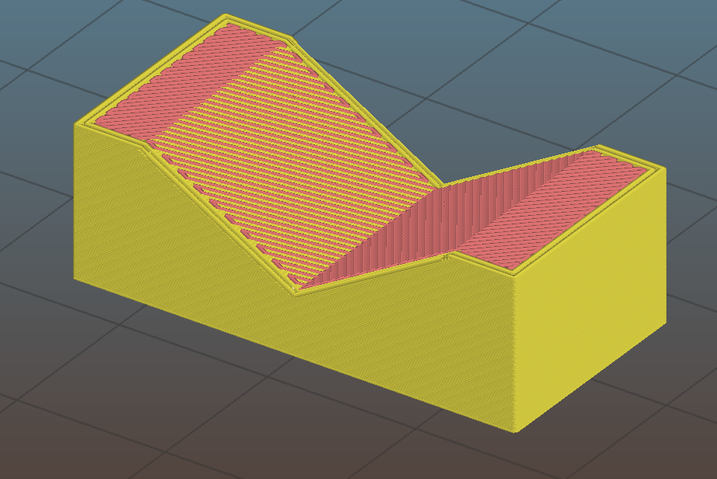
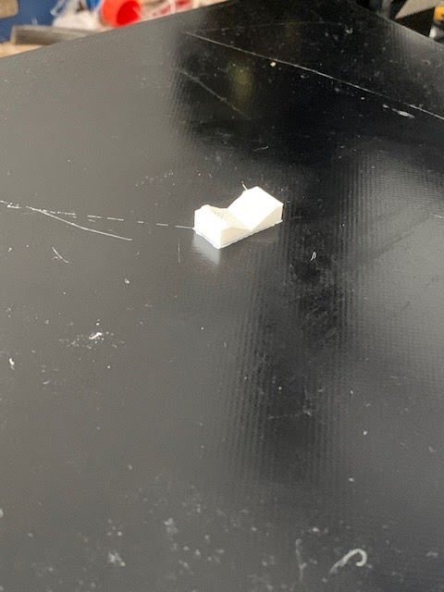
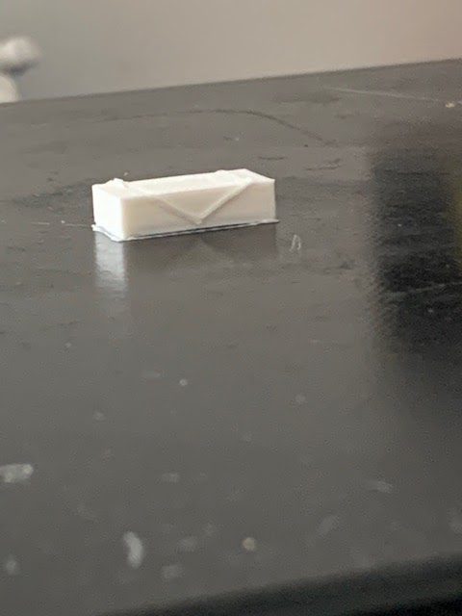
Slicing
Used to generate code to run 3d printer
Using modified Slic3r software
To simulate damage, pieces are sliced in two parts
Bottom Part represents damaged component
Top part represents the “repair”
Before
After
Notes:
(with known geometry)
(filling)

Slide 12
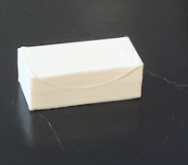
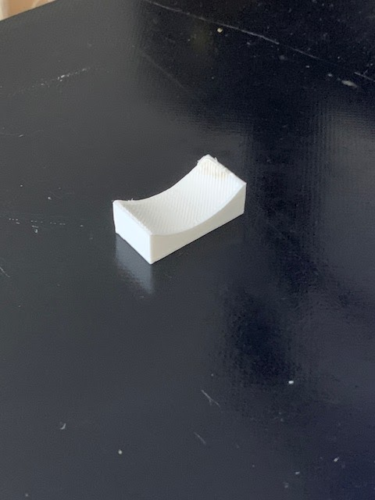
Insitu conformal print pictures
Before
After
Before
After
T1 design
T3 design
Notes:
Aidan
Test cases for slicing
Remove t1 t3

Slide 13
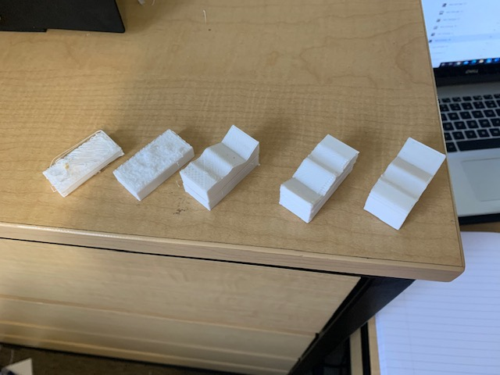
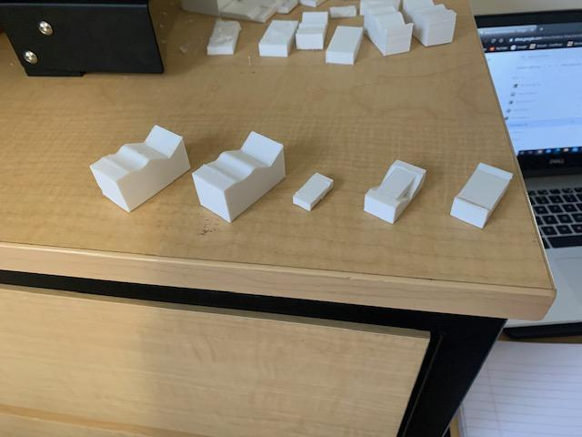
Progression of prints
We have experimented with a multitude of different variables on our way to a successful insitu conformal print
To large layer
Height (.2 mm, 20% infill) part 1
To large layer
Height (.2 mm, 20% infill) part 2
To large layer
Height (.16 mm, 20% infill)
Belt became unstable (.12 mm, 20% infill)
Perfect (.12 mm, 20% infill)
Corner raised (fixed by closing window and using hairspray) (.12 mm, 100% infill)
Perfect (.12 mm, 100% infill)
Insitu conformal print, T1 small (.12 mm, 100% infill)
Insitu conformal print, T1 big (.12 mm, 100% infill)
Insitu conformal print, T3 big (.12 mm, 100% infill)
Notes:
Aidan
[what is the impact of the slide]

Slide 14
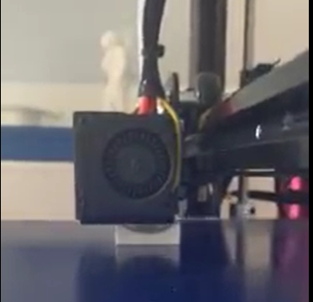
Timelapse of filling technique
https://drive.google.com/file/d/1SIsFkpwgErFRcWb_nHmTRIWihbjMZVJK/view?usp=sharing
Notes:
Aidan

Slide 15
Methodology

Slide 16
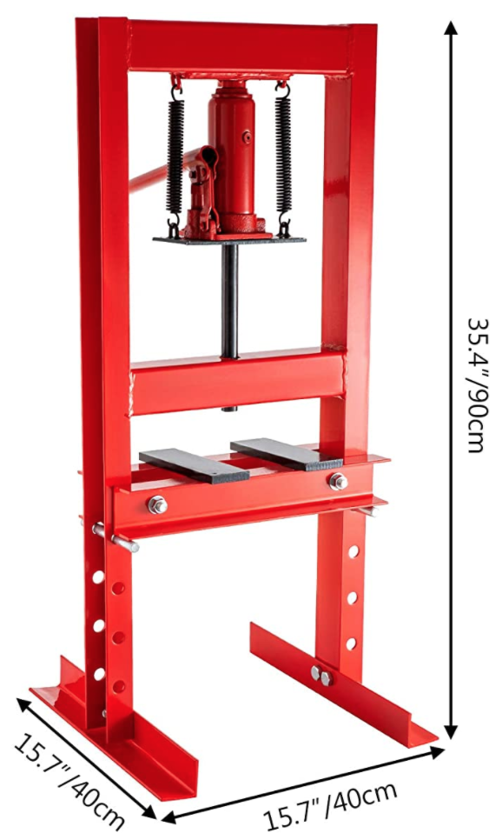
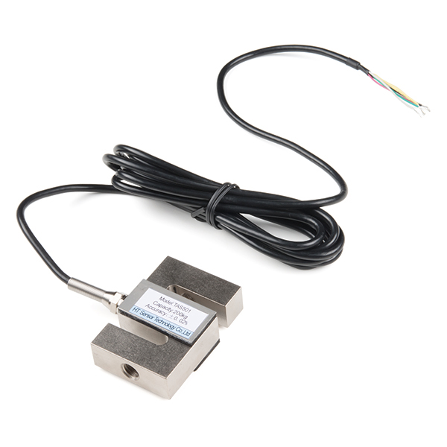
Testing Setup
Lost access to campus testing laboratories
3 Point Bend Test (ASTM D790)
Strain Gauge
Load Cell
Arduino Uno used for measurements and output
[drawing of test]
[4]
[3]
Notes:
D790 (3 Point Bend Test) used commonly for 3D printed PLA Testing
Clean part with alcohol and attach strain gauge on bottom directly under loading point
Instrument used to measure the strain on an object
Place part onto the press where it will be supported by the D shaft on either ends and secured using glue and clamps
Load cell attached onto the press to measure the total force put onto the part
Arduino Uno is attached to the strain gauge and load cell to monitor the strain and force
Hand Press → press rate will be monitored through the readings of the strain, force, and/or displacement rate as it is pressed
Use ruler to record displacement
Recorded data → stress/strain curves, determine strength-to-weight ratios, create force vs. displacement graphs.

Slide 17
Experimentation
Infill Testing | Damage Testing
Parts printed at 20%, 50%, 75%, 100% 6 parts printed with specified infill (Control) 6 parts printed with repairs done with conformal printing Used to determine the best balance of strength with print time | Parts printed at infill determined from Infill Testing 6 control Parts 4 damaged geometries 6 Parts with unrepaired damaged geometry 12 Parts with repaired damaged geometry Upper and lower bound of ultimate strength from control and unrepaired parts
48 Samples | 78 Samples
Notes:
Talk about how this is just initial avenues of testing
For each test, 6 samples will be printed to account for mistakes in testing.
These tests will be used to compare the ultimate stress of the parts from the stress strain graphs generated by the arduino for the 3 point bend test. The goal of this will be to compare the ultimate stress of these parts with the time it takes to print. This will allow us to see at what point there is diminishing returns to find the optimized infill that will have the best balance of print time with strength. This test will also allow us to see whether the infill's effects on strength are differ between the solid control parts and the conformal printed repairs.
Using the results from the infill testing, for damage testing the parts will be printed at the infill with the best balance between strength and time.
These tests will be used to compare the strength of the parts through the stress strain graphs generated from the arduino from the 3 point bend test. The ultimate stress of these geometries at the infill found from infill testing will be compared to the control. The control will give the upper bound of the ultimate strength while the unrepaired parts will give the lower bound allowing for accurate comparison of the efficacy of the repaired parts. This comparison will give information on how effective conformal repairs are for each geometry and whether conformal repairs in general can be comparable to the ultimate stress of a control part.
In total 126 parts will be printed in PLA for these 2 tests
Given the speed of initial PLA tests, further testing using carbon fiber composites or other 3D printed materials may be used to further test stronger materials.
Another avenue of research that can be done time permitting is testing the difference in repair efficacy between conformal repairs using nonplanar printing and repairs using steps.

Slide 18
Goals

Slide 19
Moving Forward: Goals & Project Timeline

Slide 20
Applications

Slide 21
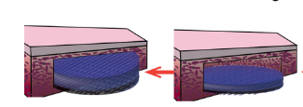
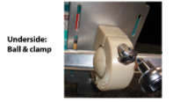
How We Will Do Good
Applications in the healthcare industry
3D printing can be used to repair bone defects [5]
FDM can be used to print scaffolds for bone and tissue regeneration [5]
Applications in education and public relations
Conformal printing could be used to repair parts for experiments on the ISS that are damaged
Many of these projects are designed by students and used to educate the public [6]
3D printed scaffold inserted into bone defect
[5]
Plastic foot restraint on ISS, designed by high schooler students
[6]
Notes:
In addition to our current research, there are many potential future applications for conformal 3D printing that would benefit our society. In the healthcare industry, biomedical engineers are developing methods of printing scaffolds that are used to repair bone defects, but for now they are limited to defects of relatively simple shapes. Our conformal printing methods can be used to broaden the types of bone defects that can be successfully repaired with these scaffolds. In the field of education, conformal printing can be used to repair experiments that are in progress in space in order to benefit the students who designed them and those who will learn from them, and it can be implemented in future experiments.

Slide 22
Conclusion

Slide 23
Conclusion
Identified
Created a feasible timeline for the future
Completed important milestones
Preparing for data collection and analysis
Despite COVID-19 setbacks we are moving forward!
Notes:
Identified

Slide 24
Citations
[actual 1 image] “| AsphaltPro Magazine | How to Crack Seal Right, Step By Step,” AsphaltPro Magazine. https://theasphaltpro.com/articles/crack-seal-right-step-step/ (accessed Oct. 27, 2020).
[1] A. J. Pinkerton, W. Wang, and L. Li, “Component repair using laser direct metal deposition,” Proceedings of the Institution of Mechanical Engineers, Part B: Journal of Engineering Manufacture, vol. 222, no. 7, pp. 827–836, Jul. 2008, doi: 10.1243/09544054JEM1008.
[2] S. Yin et al., “Cold spray additive manufacturing and repair: Fundamentals and applications,” Additive Manufacturing, vol. 21, pp. 628–650, May 2018, doi: 10.1016/j.addma.2018.04.017.
[3]https://www.amazon.com/Mophorn-Hydraulic-H-Frame-13227lbs-Plates/dp/B07WQVX5B1/ref=sr_1_2?dchild=1&keywords=press&qid=1601933154&sr=8-2
[4] https://www.sparkfun.com/products/14282
[5] L. Zhang, B. N. Johnson, and G. Yang, “Three-dimensional (3D) printed scaffold and material selection for bone repair,” Acta Materialia , 2018.
[6] “Student Experiments Launched to the ISS on NG-10,” Space Station Explorers, 23-Nov-2018. [Online]. Student Experiments Launched to the ISS on, Restraint. Students participating in NASA’s “High-school... More . [Accessed: 20-Oct-2020].

